Slide 1
Plus FCE Opinion Piece

Slide 5
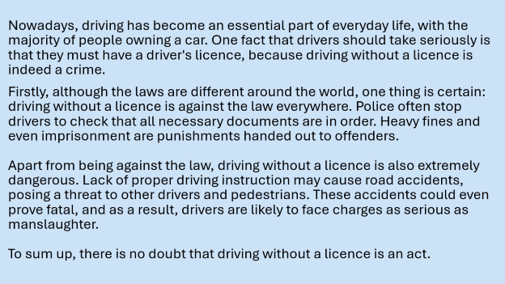
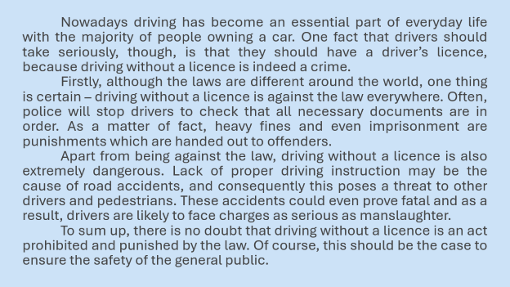
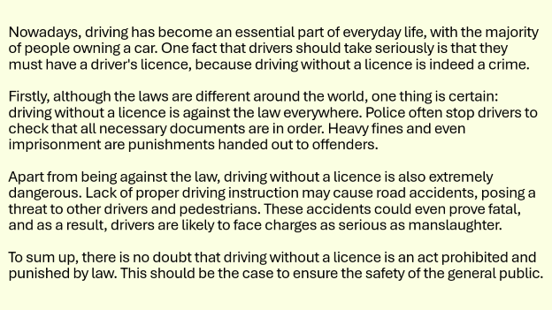
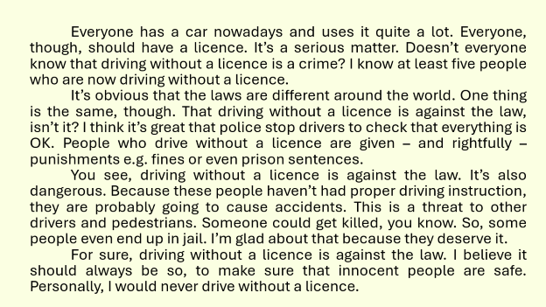
3. Why is driving without a licence considered a crime?
A
B

Slide 6
Nowadays driving has become an essential part of everyday life with the majority of people owning a car. One fact that drivers should take seriously, though, is that they should have a driver’s licence, because driving without a licence is indeed a crime.
Firstly, although the laws are different around the world, one thing is certain – driving without a licence is against the law everywhere. Often, police will stop drivers to check that all necessary documents are in order. As a matter of fact, heavy fines and even imprisonment are punishments which are handed out to offenders.
Apart from being against the law, driving without a licence is also extremely dangerous. Lack of proper driving instruction may be the cause of road accidents, and consequently this poses a threat to other drivers and pedestrians. These accidents could even prove fatal and as a result, drivers are likely to face charges as serious as manslaughter.
To sum up, there is no doubt that driving without a licence is an act prohibited and punished by the law. Of course, this should be the case to ensure the safety of the general public.

Slide 7
Everyone has a car nowadays and uses it quite a lot. Everyone, though, should have a licence. It’s a serious matter. Doesn’t everyone know that driving without a licence is a crime? I know at least five people who are now driving without a licence.
It’s obvious that the laws are different around the world. One thing is the same, though. That driving without a licence is against the law, isn’t it? I think it’s great that police stop drivers to check that everything is OK. People who drive without a licence are given – and rightfully – punishments e.g. fines or even prison sentences.
You see, driving without a licence is against the law. It’s also dangerous. Because these people haven’t had proper driving instruction, they are probably going to cause accidents. This is a threat to other drivers and pedestrians. Someone could get killed, you know. So, some people even end up in jail. I’m glad about that because they deserve it.
For sure, driving without a licence is against the law. I believe it should always be so, to make sure that innocent people are safe. Personally, I would never drive without a licence.

Slide 8
Good range of structures: complex sentences (“although the laws are different…”, “as a result…”), passive forms (“are handed out”), and modal meaning (“may cause”).
Use of simple and basic grammatical structures. e.g. “It’s a serious matter.”

Slide 9
No use of first person. The tone is impersonal and formal.
Frequent use of first person.
e.g. “I know…”, “I think…”
Uses a fairly wide and formal vocabulary (e.g. essential, majority, imprisonment, offenders, manslaughter, pose a threat, prohibited,
pedestrians.)
Limited range of basic vocabulary. e.g. “OK”, “a lot”, “get killed”

Slide 10
Clear cohesive devices: Firstly, although, Apart from, also, as a result, To sum up.
Limited use of linking words. e.g. “So”, “Though”
Frequent use of contractions. e.g. “It’s”, “Doesn’t”, “haven’t”
None used.
Fully formal style.
Use of rhetorical questions. e.g. “Doesn’t everyone know that driving without a licence is a crime?”
None used.

Slide 11
Why Essay A is the better essay.
Clear Structure: Essay A follows a logical structure with an introduction, clear main points, supporting arguments, and a conclusion. Each paragraph has a clear purpose, making the essay easy to follow.
Formal Tone: The language in Essay A is formal and appropriate for an academic essay. It avoids slang and personal anecdotes, which makes it more suitable for the task.
Relevant Arguments: Essay A provides strong reasons why driving without a licence is a crime, such as legal consequences and public safety risks. It explains both the legal and safety aspects in detail.
Use of Examples: The essay gives concrete examples, such as the possibility of fines, imprisonment, and even manslaughter charges if accidents occur.
Effective Conclusion: Essay A ends with a clear summary that reinforces the main argument and connects back to public safety.

Slide 12
Comparison with Essay B:
• Essay B is less formal and includes personal opinions and anecdotes (e.g., "I know at least five people who are now driving without a licence"), which are less appropriate for a discursive essay.
• The structure of Essay B is less organized, with ideas presented in a more conversational and repetitive manner.
• Essay B uses rhetorical questions and informal language, which weakens its academic tone.
In summary, Essay A is better because it is well-organized, uses formal language, provides clear arguments, and effectively addresses the essay prompt.

Slide 19

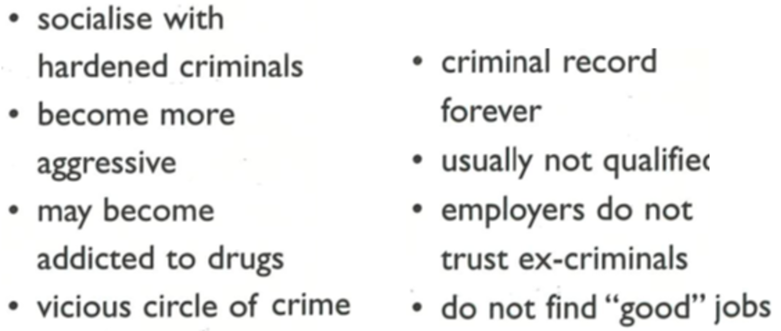

Slide 20
They may meet older criminals who can have a bad influence on them. As a result, instead of improving their behaviour, they may learn new crimes. In addition, prison can be a violent and stressful place, which can affect young people’s mental health. Therefore, sending teenagers to prison can make the situation worse rather than better.

Slide 21
Employers may not want to hire someone with a criminal record. As a result, these young people may feel frustrated and excluded from society. Because of this, they might return to crime as the only way to survive. Therefore, sending teenagers to prison can have long-term negative effects on their future.

Slide 22
Instead of prison, they should be given education and support to help them change their behaviour. This will help them become better members of society and reduce crime in the future.

